Slide 1

HOS303A: International Restaurant Concepts
Topic 4

Slide 2

International Restaurant Concepts
The Menu

Slide 3
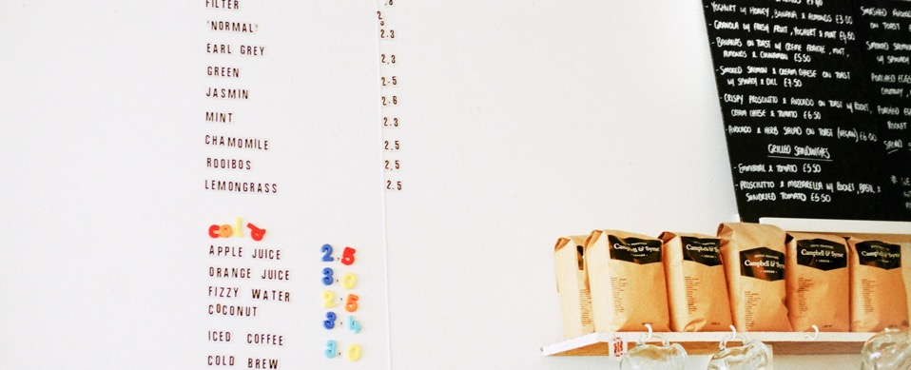
Weekly Content
The history of the menu
Factors to consider when planning a menu
Common menu types.
Factors to consider when determining a menu’s design and layout.
Ingredient sourcing, ethical, dietary requirements
Considering local palates
Soho House Example- a sense of place in multi-site concepts.

Slide 4
Concept and Market
Quality
Menu
Price
Atmosphere
Location
Management
Food
Service
(Walker, 2014, page 67)

Slide 5

Activity 4.1 Review
How did you get on?
Did any of the answers surprise you?

Slide 6
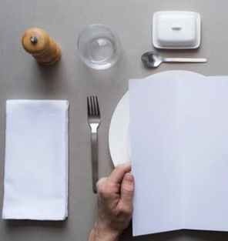
The History of the Menu
Menu relates to the Latin word minutus meaning a detailed list
Table d'hôte = "table of the host” menu
  Multi-course meals with only a few choices are charged at a fixed price
French Revolution in 1789 transformed restaurants and the evolution of food service
(Ford, Hunter, Tinton & Rippington, 2015, page 284)

Slide 7

The Importance of a Menu
A menu projects your brand out to the market you want to attract and solidifies it in consumers’ minds- It’s your personality and who you are
The layout of the menu reflects your restaurant personality- share plates, tapas, banquet, sides etc.
Food is not typically the number one driver of return visits — overall experience and rewards of choice are.
Have you ever returned to a restaurant even if the food wasn’t mind blowing? Why?
(Rewards Network, 2019)
Notes:
Full source is linked in the Essential resources on moodle.

Slide 8

Using the analogy of restaurants to theatres, the menu is the program.
The cooks and front of house are the actors, and the decor is the stage set…

Slide 9
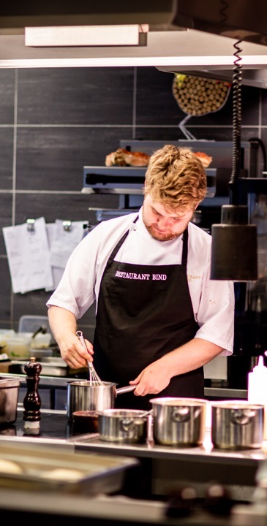
Considerations in Planning a Menu
Capability of cooks and consistency of preparation
Equipment capacity and layout
Seasonal availability of menu ingredients
Price and pricing strategy
Nutritional value
Accuracy in menus
Menu items
Menu types
Menu engineering
Menu design and layout
Standardised recipes
Menu trends
(Walker, 2014, page 107)

Slide 10
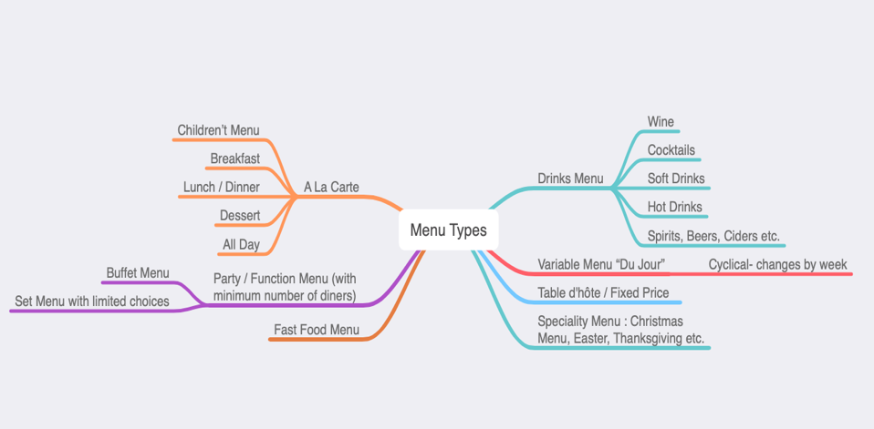
Types of
Menus
Question: Can you think of any not listed?
* There is some cross over between the ones listed.
(Adapted from Ford, Hunter, Tinton & Rippington, 2015, page 284)

Slide 11
Seasonality: Reasons to incorporate seasonal ingredients?
Guests enjoy variety and fresh new flavours…
Seasonal foods add dynamic to your existing menu options
Seasonal foods are usually less expensive than some other menu items because of their abundance- more restaurant savings
Using out of season ingredients could lead to more waste as it’s not fresh and therefore more prone to decomposition.
Staff engagement- let them shine!
Opportunity to support local suppliers- farm to table aesthetic
Refer to the Australian Food Guide here: http://seasonalfoodguide.com
Notes:
Refer to the Australian Food Guide here: http://seasonalfoodguide.com
Seasonal Food Guide in Sydney: http://seasonalfoodguide.com/sydney-nsw-seasonal-fresh-produce-guide-fruits-vegetables-in-season-availability-australia.html

Slide 12
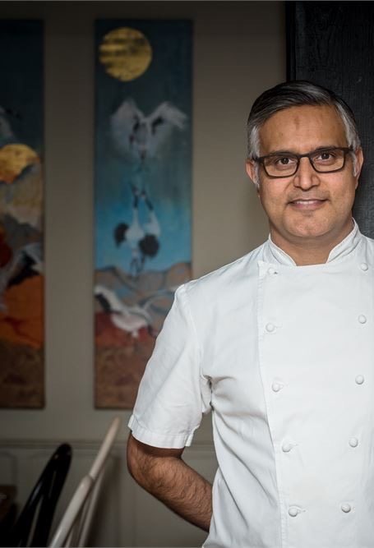
4.3 Pearls of Wisdom
“How I Create a Menu” with Atul Kochhar
Atul began his cooking career in top hotel restaurants in India. In 1994 his talents took him to London, where he opened fine-dining Indian restaurant Tamarind in Mayfair.
In 2001, Atul became the first Indian chef to win a Michelin star. He's opened restaurants in New Delhi, Mauritius and London. He’s a writer of successful cook-books, launched a new restaurant in 2019.
In this video, Atul talks through how he approaches menu design and how seasonality and local produce is key…
Notes:
Video linked here: https://www.youtube.com/watch?v=QCW60dG6y4c&feature=youtu.be

Slide 13
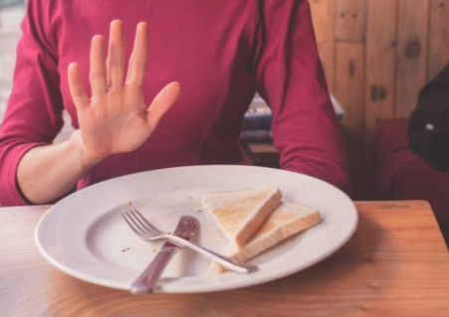

Dietaries…
Food Intolerances
Allergies
Diets- vegetarian, vegan, paleo, religious and cultural
Preferences- Organic, Pesticide free, Non-GMO, Sustainably sourced, locally grown
(Nisbets, n.d.)
Notes:
https://www.nisbets.com.au/restaurant-dietary-requirements-guide

Slide 14
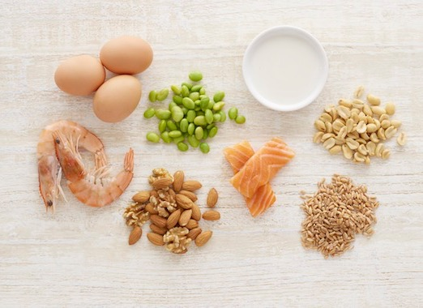
Allergies: Eating that meal could kill you…
“It’s treated as a dislike, rather than an allergy. I’ve had a few chefs and waiters tell me to my face that it’s not a real allergy, but a preference.”
According to the Food Standards Agency (UK), an estimated 2 million people have a food allergy, with an average of 10 food-allergy-related deaths a year.
If restaurant staff aren’t properly trained, allergen-free meals can easily be contaminated.
(Kale, 2019)

Slide 15

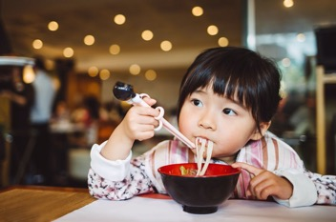
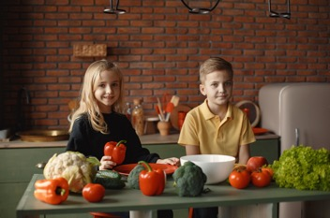
Children’s Menus
One in four Aussie children are overweight or obese
Parents want something appealing to children and healthy
"Now, parents still want to have fun and go out and include their kids, too, while giving them something nutritious and interesting to eat."
Activity packs beyond colouring in books and pencils- it needs to be strategic, on brand and memorable
(Wilden, 2019)

Slide 16

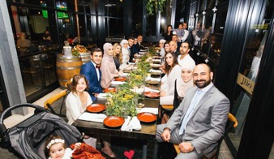
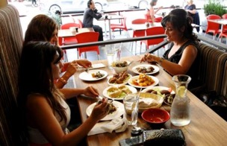
4.4 Activity: Compare restaurant menus from Dubai and Sydney
Review the menus from 2 restaurants- Both are Lebanese in different parts of the world.
How do they compare in terms of dietary requirements and children’s offerings?
Notes:
Al Aseel Menu Sydney here: http://alaseel.com.au/wp-content/uploads/2016/11/Al-Aseel-Greenacre-Menu.pdf
Miramin Restaurant Dubai here: https://lms.icms.edu.au/pluginfile.php/399691/mod_resource/content/1/Topic%204%20Activity%20ResourceMir%20Amin%20menu%202020.pdf

Slide 17
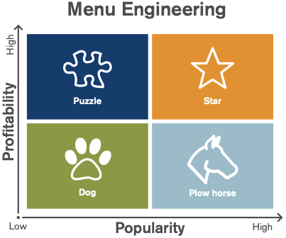
Menu Engineering
80% of your profits come from about 20% of your menu items
Star (high profit, high popularity):
dishes that people love and that make you money.
Plow horse (low profit, high popularity): dishes that people love and that you break even on — but make up in volume.
Dog (low profit, low popularity): dishes that do not get ordered and that cost you a lot of money to prepare.
Puzzle (high profit, low popularity): Dishes that do not get ordered, but that would make you money if they did.
(Restaurant Profit Margin ,Rewards Network, 2019, pages 16-19)

Slide 18
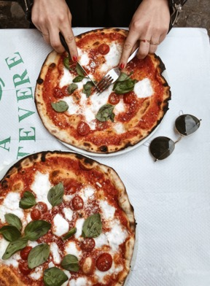
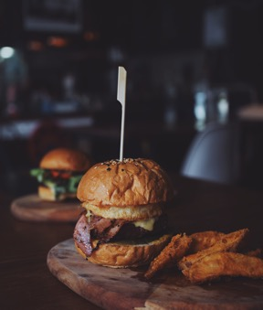
Menu Engineering continued…
Analysis and cross referencing:
POS system breakdown
Cost per dish (and possibly labour- how many moves in plating per dish?)
Tips
Dump the Dogs! These are not even worth tweaking
Add variety to the Plough horses- these could be potential stars! Could you offer add-ons for these dishes?
Do you need multiples of a dish?
Increase prices modestly on Stars
Any dishes that use ingredients only for that dish on the menu might need tweaking
(Restaurant Profit Margin ,Rewards Network, 2019, pages 16-19)

Slide 19
Example of Menu Engineering
(Van Duyne, n.d.)
Notes:
See here: https://pos.toasttab.com/blog/on-the-line/restaurant-menu-engineering-worksheet-free-menu-template

Slide 20
4.5 Activity: Where do you think the following dishes would fit into our quadrants? Explain your reasoning.

Slide 21
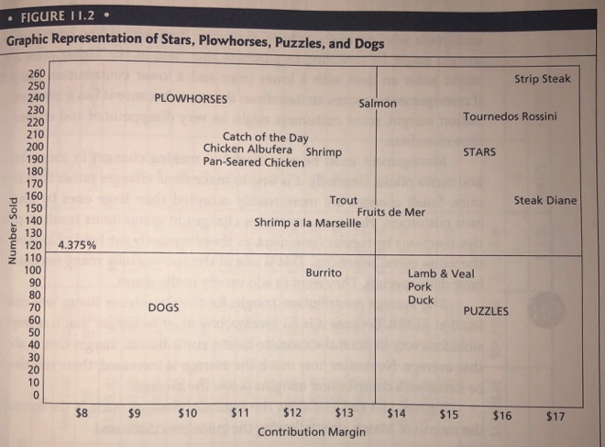
Let’s look at this example…
Be careful! The axes are switched around here.

Slide 22
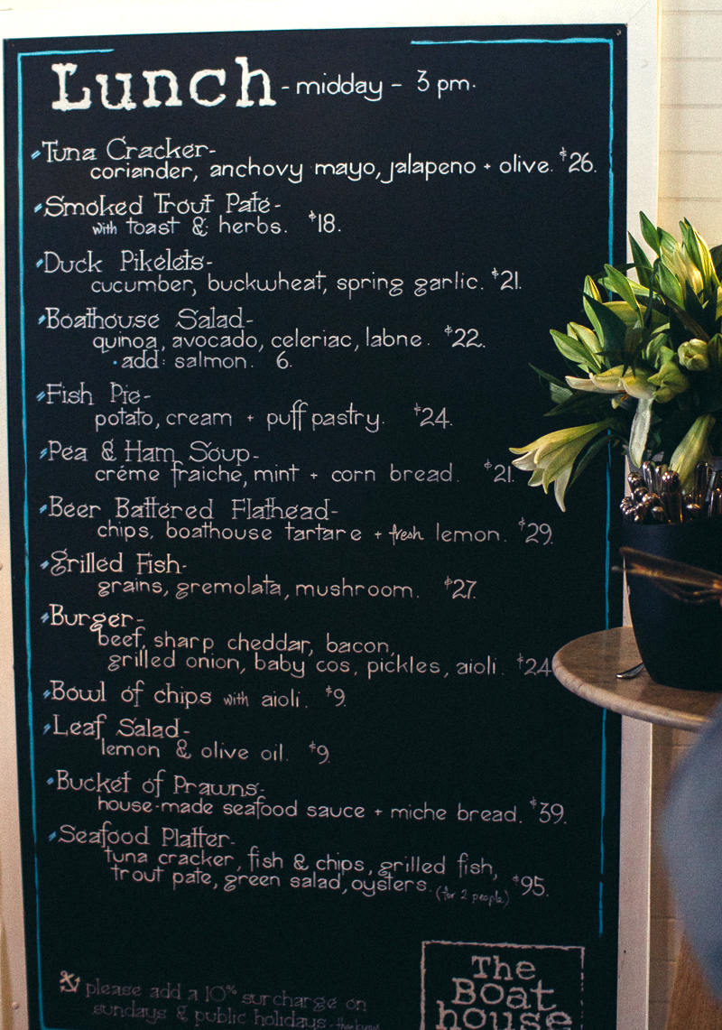

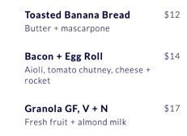
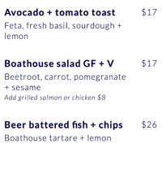
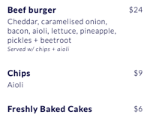

Boathouse Shelly Beach regular vs. COVID
Regular Menu
(In May, 2020)
Question
From your knowledge of menu engineering, which quadrants do you think the Boathouse were most likely to offer during COVID?

Slide 23

Menu Design and Layout
List items from most profitable to least profitable- (not by most expensive)
Group similar menu items together
Putting 5 options in each section is optimal- appetiser, mains, salads etc.
The more columns, the less control you have over where you guest’s eyes will go
Try and avoid printing on both sides- half of people never turn the menu over
(Restaurant Menu Design ,Rewards Network, 2019, pages 5- 9)

Slide 24
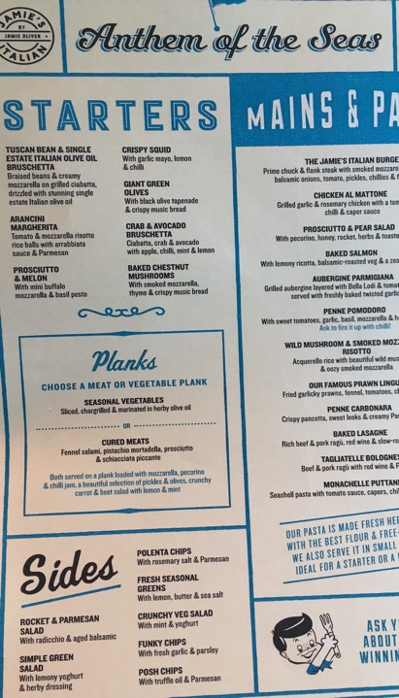
Menu Design and Layout continued
Always use the dish’s full name
Mention high quality ingredients or provenance (farm names, marble scores, Valrhona chocolate etc.)
More descriptive copy for your profitable items
Don’t boast about secret ingredients in the descriptions — studies show people taste what you tell them they’re tasting.
If a dish received a write-up in a prominent magazine, won an award, or featured on a television show, show off about it!
Menu decoys- you might not order the GIANT steak but these extreme items, encourage guests to order something in the same category but more reasonable.
(Restaurant Menu Design ,Rewards Network, 2019, pages 5- 9)

Slide 25
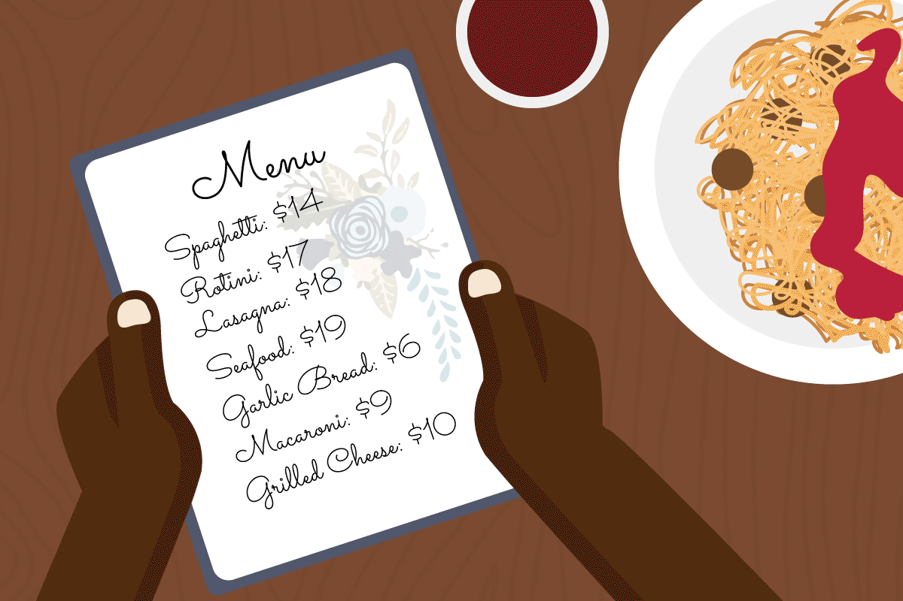
If there are no Dollar signs, are you really spending money?
Restaurant goers spent more when prices were written in numerals without dollar signs
(Stennett, 2017)
Notes:
Full article here: https://www.thepennyhoarder.com/save-money/restaurant-menu-tricks/

Slide 26
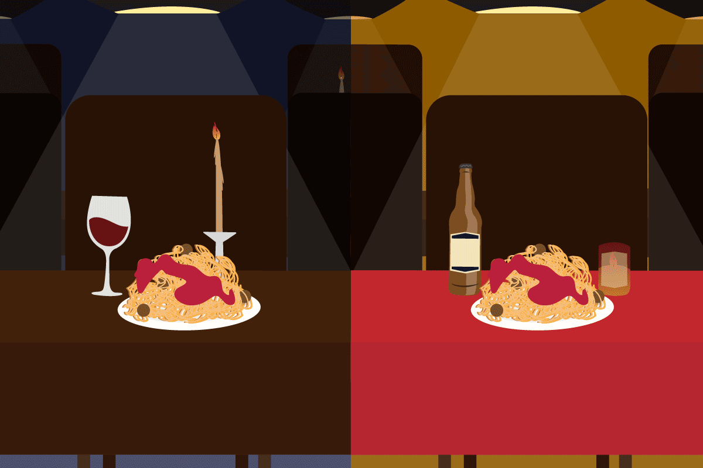
What a Difference a Penny/ Cent Makes?
Customers at cheaper restaurants may overlook a less expensive $7 option and opt for the $8.99 platter because the “9” ending makes them think they get good value.
Fine dining patrons are more likely to believe that the meal they plan to order is higher quality if the price ends in a zero and may opt for the $30 entree over the $27.99 meal.
(Stennett, 2017)
Notes:
Full article here: https://www.thepennyhoarder.com/save-money/restaurant-menu-tricks/

Slide 27
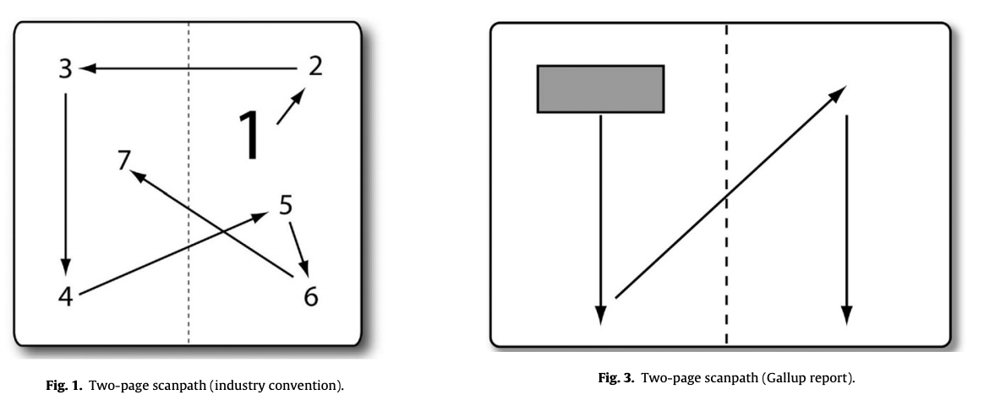
Eye movements on restaurant menus: A revisitation on gaze motion and consumer scan paths
(Yang, 2012)
Notes:
On Moodle 4.13: Yang, S.S. (2012). Eye movements on restaurant menus: a revisitation on gaze motion and consumer scanpaths. International Journal of Hospitality Management, 31, 1021-1029.

Slide 28
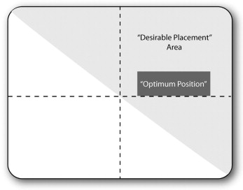
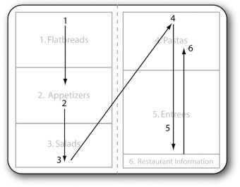
Eye movements on restaurant menus: A revisitation on gaze motion and consumer scan paths
(Yang, 2012)
Notes:
On Moodle 4.13: Yang, S.S. (2012). Eye movements on restaurant menus: a revisitation on gaze motion and consumer scanpaths. International Journal of Hospitality Management, 31, 1021-1029.

Slide 29
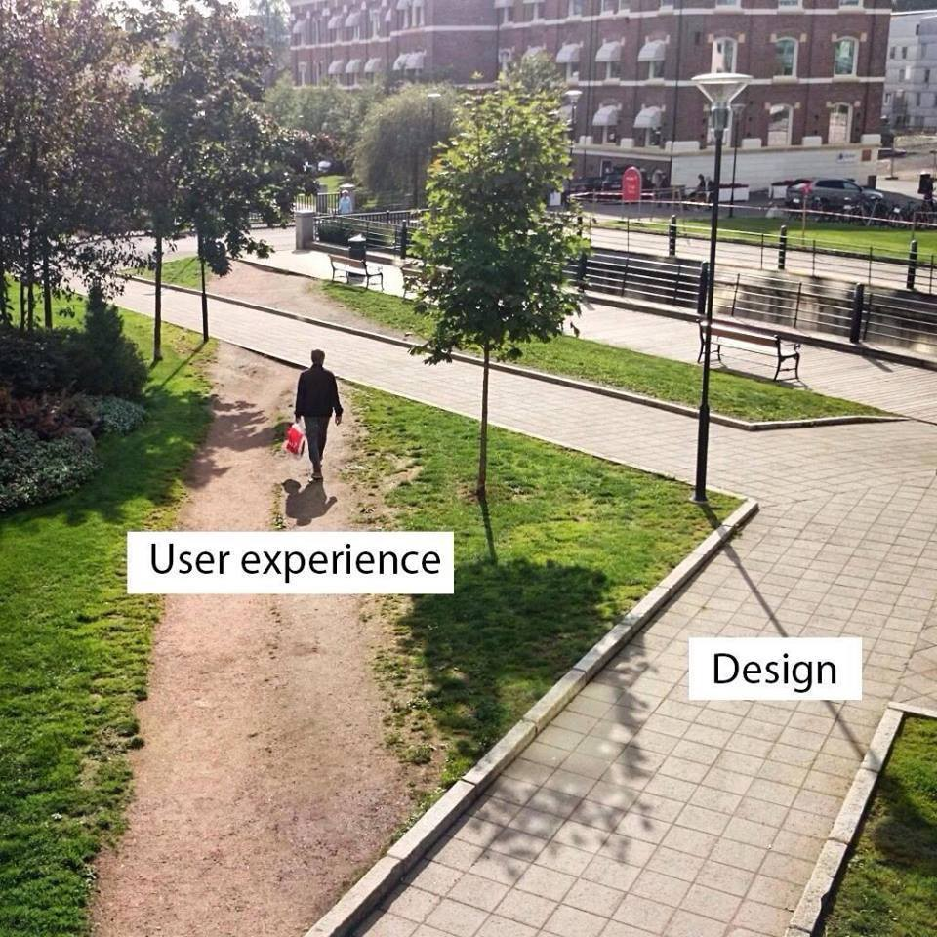
User Experience (UX) or User Interface (UI) or Design

Slide 30







Guest Speaker: Kiarne Greener
Partner Success Manger at Tyro Payments
Operations Manager at

Slide 31
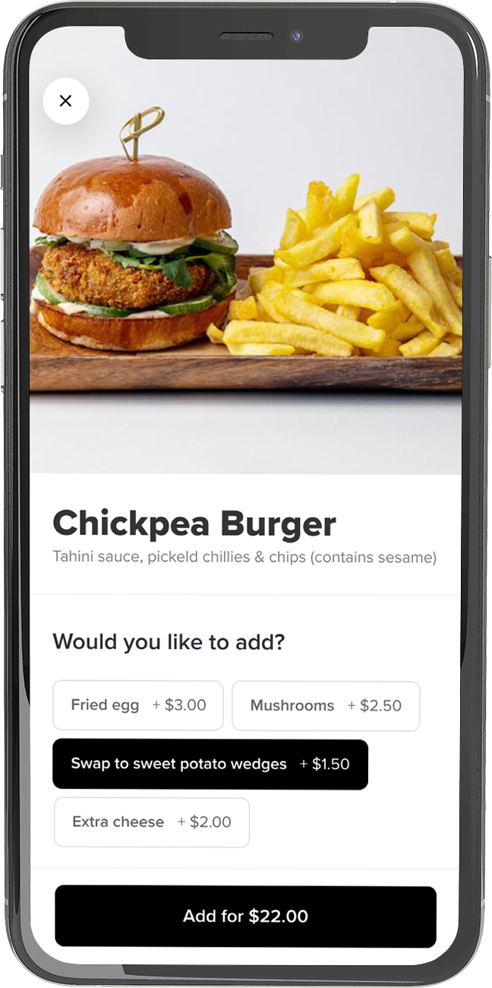

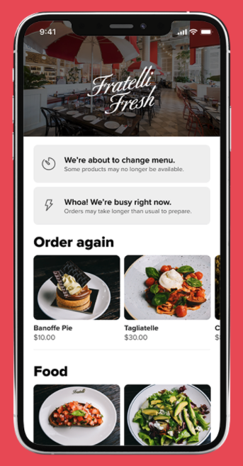
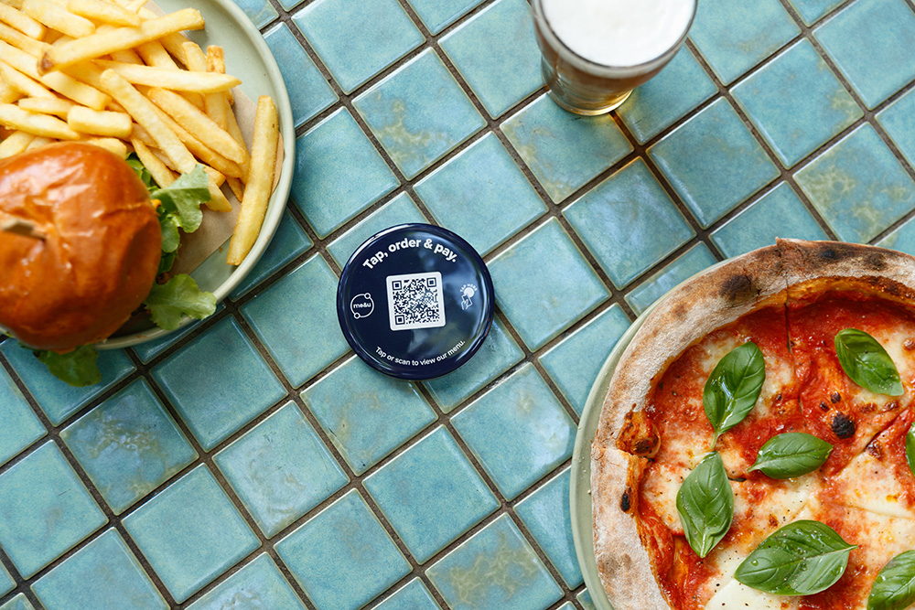
How Covid has changed menu design…
More dishes suited takeaway- can be packaged
More star dishes

Slide 32
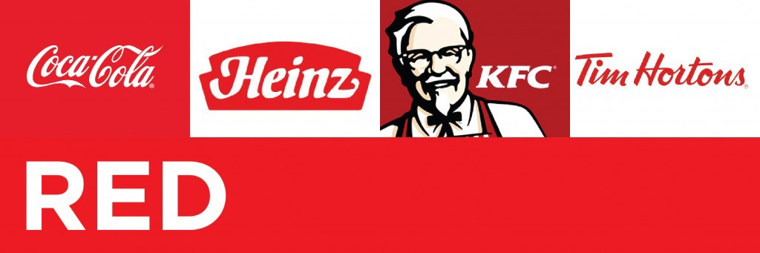
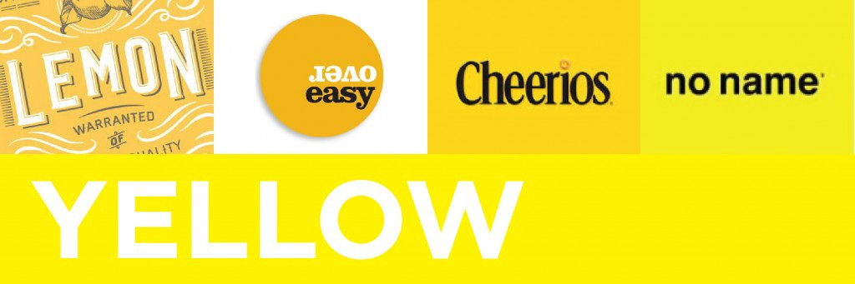
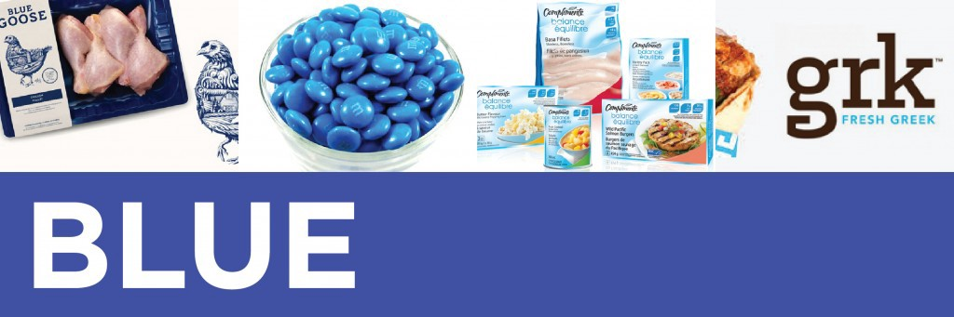

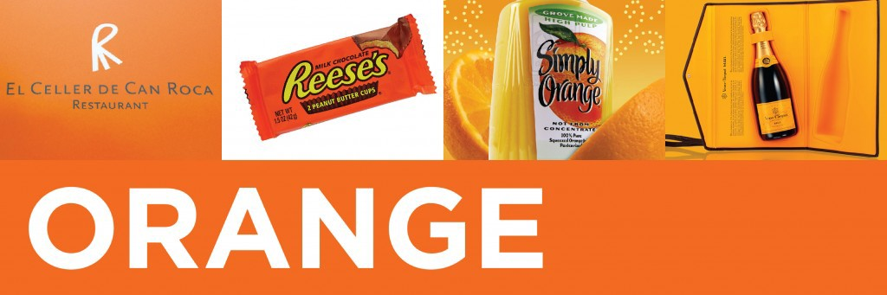

Colour Theory
(Howell, 2016)
Notes:
https://medium.com/@ashley_howell/understanding-colour-psychology-for-restaurants-brands-dbb7ffbcecae

Slide 33
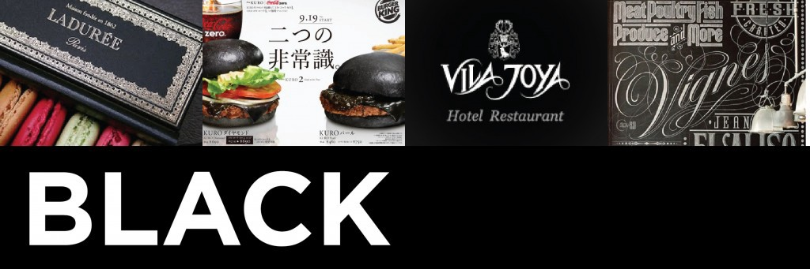
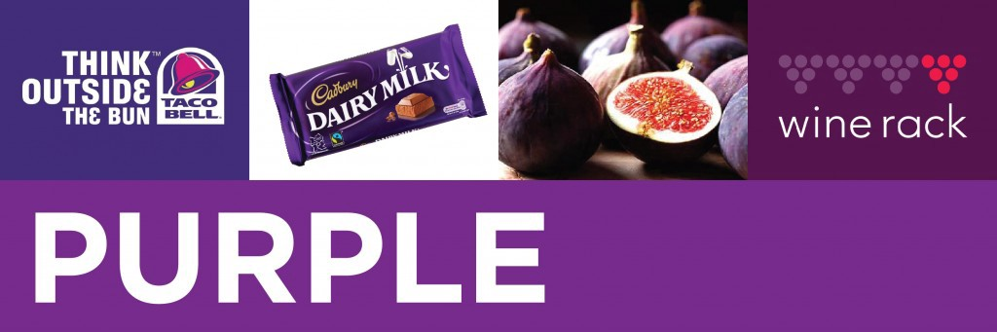
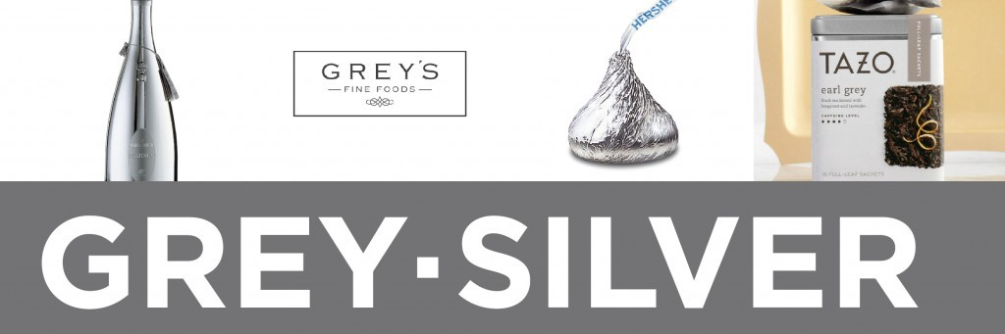

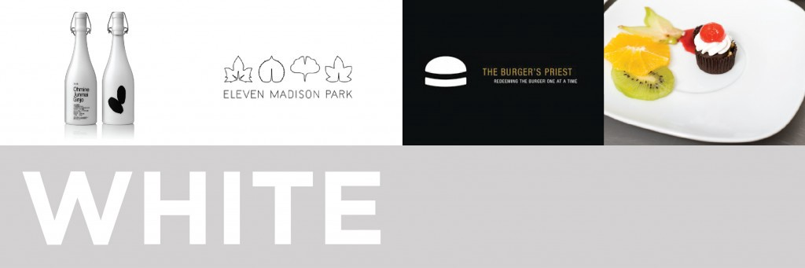
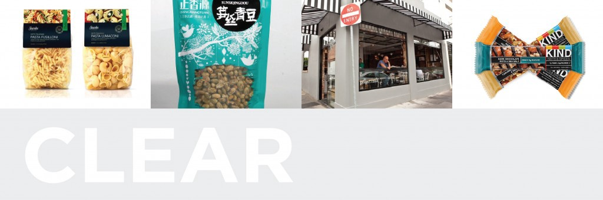
Colour Theory
(Howell, 2016)
Notes:
https://medium.com/@ashley_howell/understanding-colour-psychology-for-restaurants-brands-dbb7ffbcecae
Also check out- The Psychology of Menu Design (2020) here: https://aaronallen.com/blog/the-psychology-of-menu-design

Slide 34
4.6 Activity: Sample Menu - Critique

Slide 35
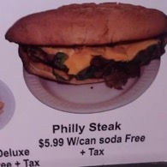
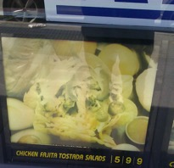
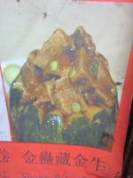
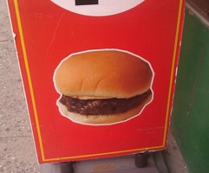
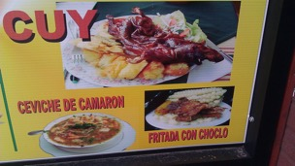
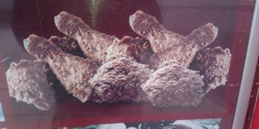
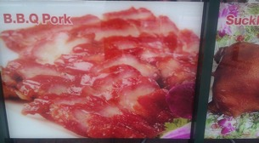
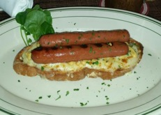

Food Photos- Yes or No?
What even are some of these?!
Some restaurants are banning diners from taking photos…
Poorly executed photos can do serious damage to your brand…
(Leon, 2017)
Notes:
Check out this FB group: https://www.facebook.com/badrestaurantfoodphotography/

Slide 36
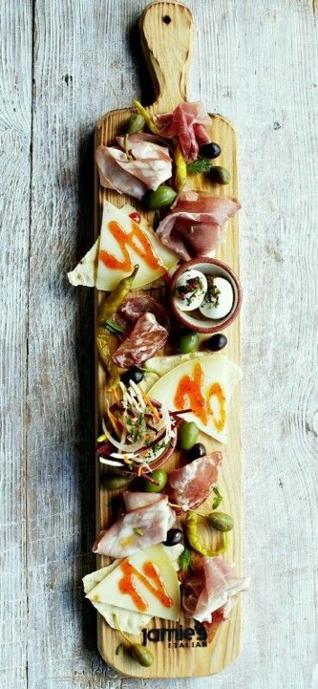



Food Photography and Styling is an Art…
Food Photographers
Food Stylists
David Loftus’ Top Tips for successful food photography
Find the Light
Use Props
Framing
Shoot from above
Use “portrait mode”
Fix it in post
(Preston, 2019)
Notes:
Check out David Loftus talk about what makes great food photography: https://www.youtube.com/watch?v=HNfi6xXecPw

Slide 37

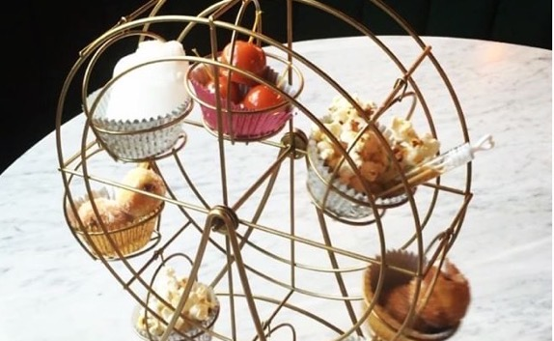
Balancing Visual Appeal, Novelty and Flavour
An example of how Olivia Casson deliberately designed a dessert for Instagram
*Images supplied by Olivia Casson

Slide 38

4.7 Pearls of Wisdom
“Food Styling” with Olivia Casson
Having worked as a chef and Head chef in Michelin starred venues, she progressed to Operations Manager for a successful chain of Italian restaurants in the UK. She then moved into restaurant consulting and food styling and her clients have included the BBC.
Currently, Regional Operations Manager for Compass, Olivia still offers consulting services having worked for several companies as a freelancer in Sydney.
In this video, Olivia talks through how she approaches menu design: From Concept to Menu
Notes:
Read more here: https://oliviacasson.com/?doing_wp_cron=1590642408.1072299480438232421875
Link to her interview video here: https://www.youtube.com/watch?v=wiNJ5DVuVIw&feature=youtu.be

Slide 39
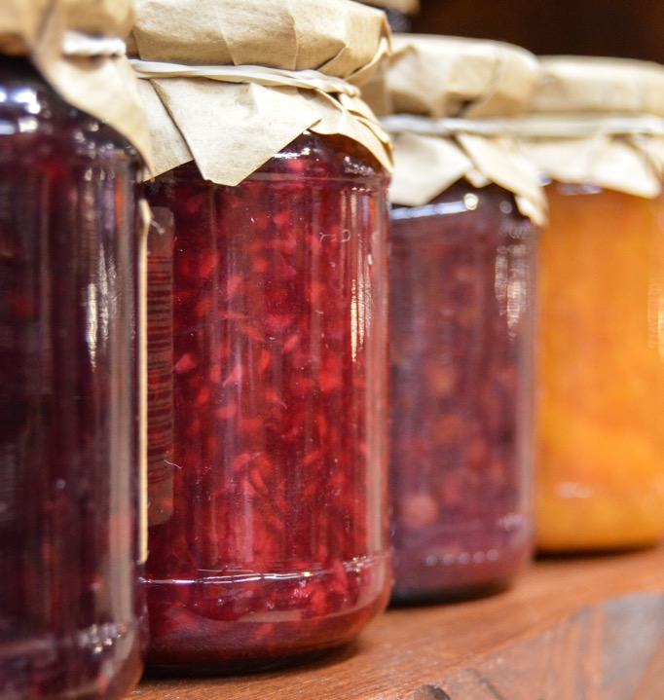
Menu Pricing and Size
Covering costs of ingredients
Costs of labour and utilities (More on this in future weeks)
How do your current menu items measure up in price against similar dishes at other establishments in your area?
Balance the number of choices and sales
“the Paradox of Choice”- the Jam Experiment
  24 item display gathers more attention BUT people at the six item display were 10 times more likely to buy jam.
(Restaurant Menu Design ,Rewards Network, 2019, pages 11- 13)

Slide 40
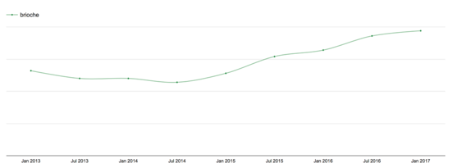


Be Aware of Trends…
“Brioche” appearing on menus
(The Food People, 2018)
(Jones, 2020)
Notes:
See Here: https://thefoodpeople.co.uk/trends/menuwatching
BBC story here: https://www.bbc.com/news/business-44488051

Slide 41

Cross Cultural Marketing:
McDonald’s Global Menu Variations
(Kotler et al, 2017)

Slide 42








Location and Product Offering
Soho House: A Sense of Place
Menu features:
House Classics with a European twist
Classic British dishes
Strong Italian influences
Shoreditch House, London
Soho House,
Barcelona
Menu features:
House Classics
Ham Croquettes, Patatas Bravas, Padrón Peppers
Mediterranean style dishes, some with an Asian twist
Soho House,
Mumbai
Menu features:
House Classics with an Indian twist
Tandoor and Grills
Curries & Rice
Indian Breads
Find other examples of how local palates are incorporated to multinational concepts
Notes:
Soho House: Shoreditch: https://www.sohohouse.com/houses/shoreditch-house/food-and-drink
Soho House Barcelona: https://www.sohohouse.com/houses/soho-house-barcelona
Soho house Mumbai: https://www.sohohouse.com/houses/soho-house-mumbai

Slide 43

4.8 Activity: Research and Share
Find Menus from different types of restaurants. Post them in the appropriate column and critique their content, layout and design
Post your findings here: https://icms.padlet.org/nassima_kennedy1/mwf032u3gglhgxal

Slide 44

Closing Thoughts…
Menus and menu planning are the most crucial elements of the restaurant.
The many considerations in menu planning help us realise the scope and depth of general planning necessary for successful operation.

Slide 45

Sources
Fleming, A. (2013, May 8). Restaurant menu psychology: tricks to make us order more. The Guardian. Retrieved from https://www.theguardian.com/lifeandstyle/wordofmouth/2013/may/08/restaurant-menu-psychology-tricks-order-more
Ford, Hunter, Tinton & Rippington, (2015). Professional chef : commercial cookery volume 2 (2nd edition). Cengage Learning Australia, South Melbourne, Victoria, Australia
Jones, L (2020, January 2), Veganism: Why are vegan diets on the rise? BBC News. Retrieved from https://www.bbc.com/news/business-44488051
Kale, S. (2019, Sep 11). 'Eating that meal could kill you': when cooks don't take food allergies seriously. The Guardian. Retrieved from https://www.theguardian.com/society/2019/sep/11/take-food-allergies-seriously-people-can-die
Kotler, P., Bowen, J., Makens, J., & Baloglu, S. (2017). Marketing for hospitality and tourism (7th ed.). Boston: Pearson. Page 180
Leon, H. (2017, Dec 6). Bad Restaurant Food Photography: Strikes Again! Huffington Post. Retrieved from https://www.huffpost.com/entry/bad-restaurant-food-photo_2_b_3111691
Preston, D. (2019, Dec 24). How to take perfect food photos. Tech Advisor. Retrieved from https://www.techadvisor.co.uk/how-to/photo-video/take-perfect-food-photos-3780609/
Poundstone, W. (2010, 21 January). How restaurants entice us into choosing expensive meals. The Guardian. Retrieved from https://www.theguardian.com/lifeandstyle/2010/jan/21/menus-cunning-marketing-ploys
Stennet, D. (2017, October 28). This Is How Restaurants Trick You Into Overspending Every Time You Dine Out. The Penny Hoarder. Retrieved from https://www.thepennyhoarder.com/save-money/restaurant-menu-tricks/
Street Food Revolution (n.d.) The Food People. Retrieved from https://thefoodpeople.co.uk/infographics/street-food
The Entrepreneur Staff Media Inc, (n.d.) How to Start a Restaurant, Entrepreneur Asia Pacific. Retrieved from https://www.entrepreneur.com/article/73384
Walker, J. R. (2017). The restaurant : from concept to operation. [Book] (8th ed.). John Wiley
Walker, J. R. (2014). The restaurant : from concept to operation. [Book] (7th ed.). John Wiley – Chapter 4
Wildren, N. (2019, May 6). The kids' menu is all grown up at these child-friendly restaurants. Good Food. Retrieved from https://www.goodfood.com.au/eat-out/news/child-friendly-restaurants-the-kids-menu-grows-up-20190501-h1dyd4

Slide 46
Thank you
What questions do you have?...
COMMONWEALTH OF AUSTRALIA
Copyright Regulations 1969
WARNING
This material has been reproduced and communicated to you by or on behalf of International College of Management, Sydney pursuant to Part VB of the Copyright Act 1968 (the Act).
The material in this communication may be subject to copyright under the Act. Any further reproduction or communication of this material by you may be the subject of copyright protection under the Act.
Do not remove this notice.

